Slide 1
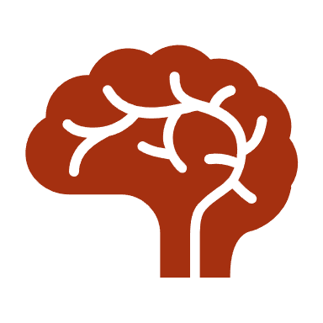
The Cerebral Cortex and Brain Structures

Slide 2
The cerebral cortex is what makes humans unique.
It is divided into four lobes.
We all possess distinct human traits such as thought, language, consciousness, ability to think, reason, and imagine.
Frontal Lobe: located at the front of the brain and is associated with:
Reasoning
Motor skills
Higher level cognition
Expressive language
Damage to the frontal lobe can result in changes in sexual habits, socialization, attention and increased risk-taking behavior (impulsivity)

Slide 3
Parietal Lobe: located in the middle section of the brain and is associated with processing tactile sensory information such as pressure, touch and pain.
A portion of the brain known as the somatosensory cortex is located in this lobe and is essential to the processing of the body's senses.
Temporal Lobe: is located on the bottom section of the brain and is the location for the primary auditory cortex which helps us interpret sounds and language.
The Hippocampus is also in the temporal lobe and it is involved with the formation of memory.
Damage to the temporal lobe can result in problems with memory, speech perception and language skills.
Occipital Lobe: located at the back of the brain and is associated with interpreting visual stimuli and information.
The primary visual cortex receives and interprets information from the retinas of the eyes is in the occipital lobe.
Damage to the occipital lobe can cause visual problems such as difficulty recognizing objects, an inability to identify colors and trouble recognizing words.

Slide 4
Brain Stem
The brain stem is comprised of the following; midbrain, pons and medulla.
The brain stem serves multiple functions, but its main function is to regulate the autonomic, most fundamental functions of the brain—regulating heart rate, controlling reflexes, breathing, and consciousness.
The midbrain is the smallest region of the brain
It acts as a relay station for auditory and visual information.
Portions of the midbrain are involved in the control of body movement.
The substantia nigra contains a large number of dopamine producing neurons.
The degeneration of neurons in the substantia nigra is associated with Parkinson's Disease.
The medulla controls many vital functions such as heart rate, breathing and blood pressure.
The Pons (the middle section of the brain stem) relays information between the cerebral cortex and cerebellum, as this is where the cerebellum is attached to the brain.
The pons connects the medulla to the cerebellum and serves a number of important functions including playing a role in several autonomic functions such as stimulating breathing and controlling sleep cycles.

Slide 5
The Cerebellum
It is referred to as the little brain and is comprised of small lobes and receives information from the balance system of the inner ear, sensory nerves and the auditory and visual systems.
It is involved in the coordination of movements as well as motor learning.
The cerebellum helps control posture, balance and the coordination of voluntary movements.
Thalamus is located above the brainstem and it processes and transmits movement and sensory information.
It is a relay station taking in sensory information and passing it on to the cerebral cortex.
The Hypothalamus
The hypothalamus is a grouping of nuclei that lie along the base of the brain near the pituitary gland.
The hypothalamus connects with many other regions of the brain and is responsible for controlling thirst, hunger, emotions, body temperature and circadian rhythms.
The hypothalamus also controls the pituitary gland by secreting hormones.

Slide 6
The Limbic System
The Limbic System is referred to as the emotional center of the brain.
It contains four structures: Amygdala, Hippocampus, Thalamus, Hypothalamus
The limbic system regulates mood, basic emotions such as fear, arousal, pleasure and anger, hunger, sex.

